Slide 1
Overview of Machine Learning
By Bhagabat Prasad Behera

Slide 2
Agenda
Paradigms in Machine Learning
Supervised Learning
Unsupervised Learning
Semi-Supervised Learning
Reinforcement Learning

Slide 3
ML Paradigms
Machine Learning
Supervised Learning
Unsupervised Learning
Semi-supervised Learning
Reinforcement Learning
Mapping input to output
Classification
Regression
Retrieval
Recommendation
Finding structure in data
Clustering
Density estimation
Manifold learning
Pattern recognition
Market basket analysis
Using unlabelled data to improve supervised learning models
Text classification
Speech recognition etc.
Learning to take actions in specific states in a sequential manner
Robotics
Gaming
Healthcare
In supervised learning, the model is given a large amount of previously labelled data to learn from. This labelled data consists of input and the corresponding output that it is expected to predict. The machine then learns from all the past data and creates a mapping between the given input and the desired output to make predictions. Within supervised learning, there are multiple applications, such as classification, regression, retrieval and recommendation.
In unsupervised learning, the data fed to the model is unlabelled, and the model has no prior knowledge about the data. Hence, the machine tries to decipher the data by identifying some structures and patterns in that data.
As the name suggests, semi-supervised learning is a combination of supervised learning and unsupervised learning. We generally apply semi-supervised learning when we have less labelled data and more unlabelled data.
As we know, labelled data is what makes AI successful. This learning paradigm helps in taking advantage of both to create labelled data.
In reinforcement learning, the model learns to make a sequence of decisions such that it is rewarded in the end.
It is quite different from supervised and unsupervised learning paradigms.

Slide 4
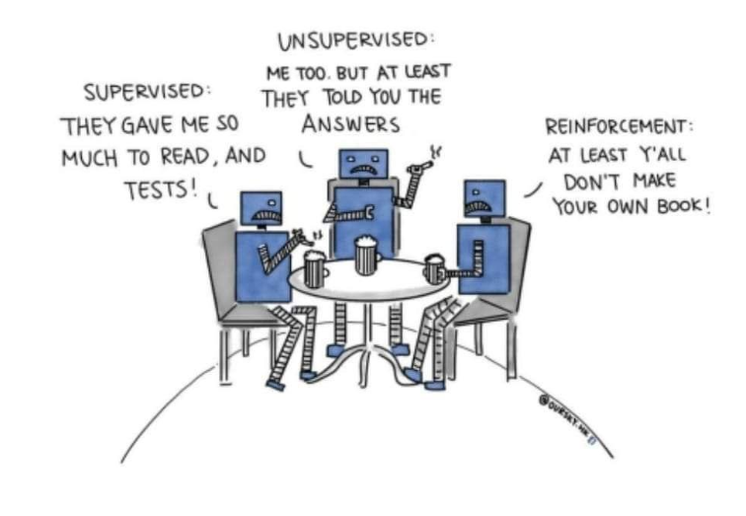
ML Paradigms
Source: OneFourthLabs

Slide 5
Supervised Learning
New data
Labelled Data
Supervised Learning algorithm
Model
Predictions

Slide 6
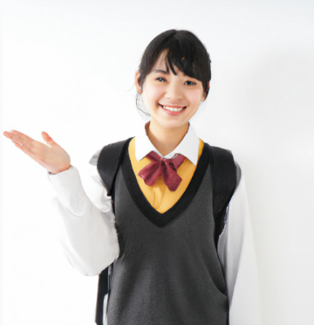
Supervised Learning
Predictions
Classification
Pass or Fail
Regression
Marks
Source: DALL-E

Slide 7
Supervised Learning: Classification
A vehicle insurer company wants to predict whether their policyholders (customers) from past year will also be interested in Vehicle Insurance for this year.
Input
Output
Discrete values

Slide 8
Supervised Learning: Regression
A vehicle insurer company wants to predict the new premium amount for their policyholders (customers) based on past year’s records.
Input
Output
Continuous values

Slide 9
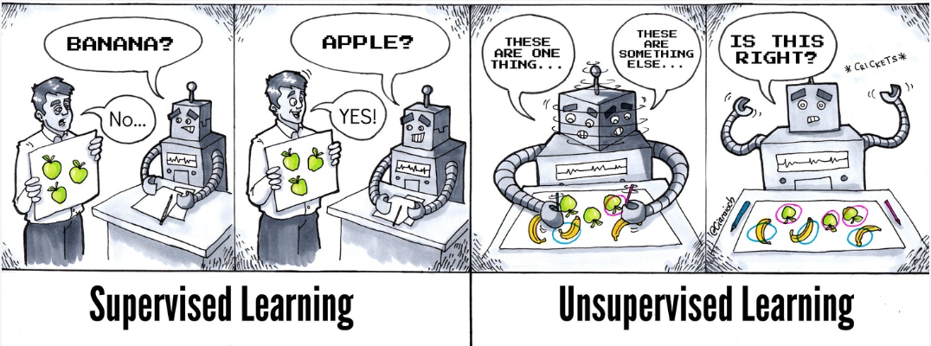
Supervised vs Unsupervised Learning
Source: SubStack

Slide 10
Unsupervised Learning: Pattern Recognition
School
Classroom
College
Students
University
Teachers
Books
Examination
Seminar
Singing
Judge
Dancing
Rock music
Judiciary
Lawsuit
Convicted
EDM
Guitar
Trial
Persecution
Books
Tomorrowland
Lawyer
Musician
Courtroom
Rock Band
Song

Slide 11
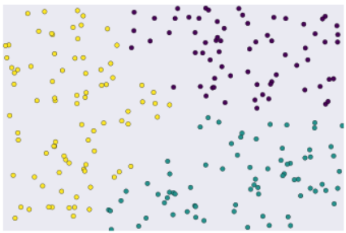
Unsupervised Learning: Clustering
Unlabelled examples grouped into three clusters.
Source: Developers.google.com
Grouping unlabelled examples is called clustering. As the examples are unlabelled, clustering relies on unsupervised machine learning. If the examples are labelled, then clustering becomes classification.
Use cases of unsupervised learning:
Market segmentation
Social network analysis
Search result grouping
Medical imaging
Anomaly detection
Grouping starts by brightness
Grouping documents by topics

Slide 12






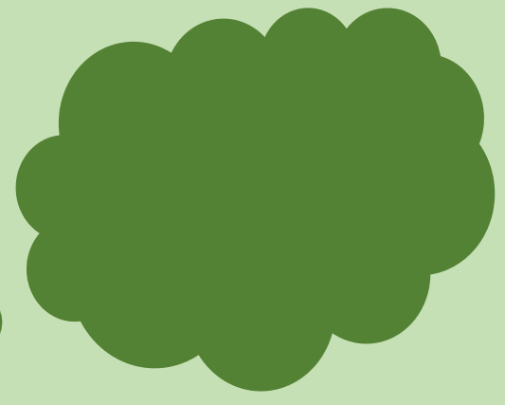
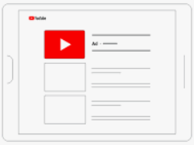
Semi-Supervised Learning
Classification
1. Train a model with few labelled data
Cartoon vs Non-cartoon
3. Retrain the model including newly labelled data
2. Generate additional labelled data from predictions
10 bn+ YouTube videos

Slide 13

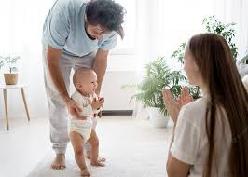



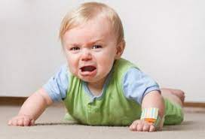
Reinforcement Learning
Baby walks successfully
Complement
Baby attempts to walk
Baby falls
Pain
Credit: Individual images taken from iStock

Slide 14
Reinforcement Learning
Example: Tic-Tac-Toe
x
 | o | x
x | o
 | o | x
x |  | o
 | o | x
x
 | o | x
 |  | o
x
 | o | x
 | o
x
 | o | x
o
x
o | o | x
Summary
Learning is solely based on exploration and reward
Learning what to do and how to map situations to actions so as to maximise reward

Slide 15
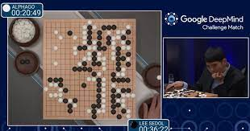
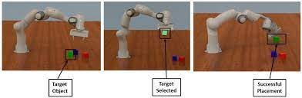
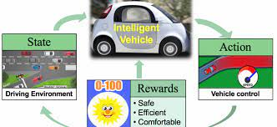
Reinforcement Learning Applications
Reinforcement Learning based AlphaGo program went on to beat a 9-dan (the highest rank) professional Go player in 2016, and the #1-ranked Go player in the world in May 2017.
Reinforcement learning offers to robotics a framework and set of tools for the design of sophisticated and hard-to-engineer behaviours.
When it comes to making decisions for Self Driving technology, we use deep reinforcement learning (DRL).

Slide 16
Thank you!

